Slide 1
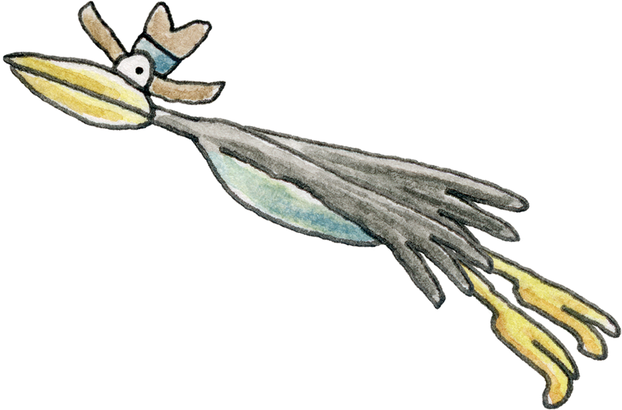
Passwords and Passcodes

Slide 2
Let’s learn about what passcodes and passwords are for, when we use them. and how we can make them more secure.
We can play a game to choose a new 3 random word password.

Slide 3
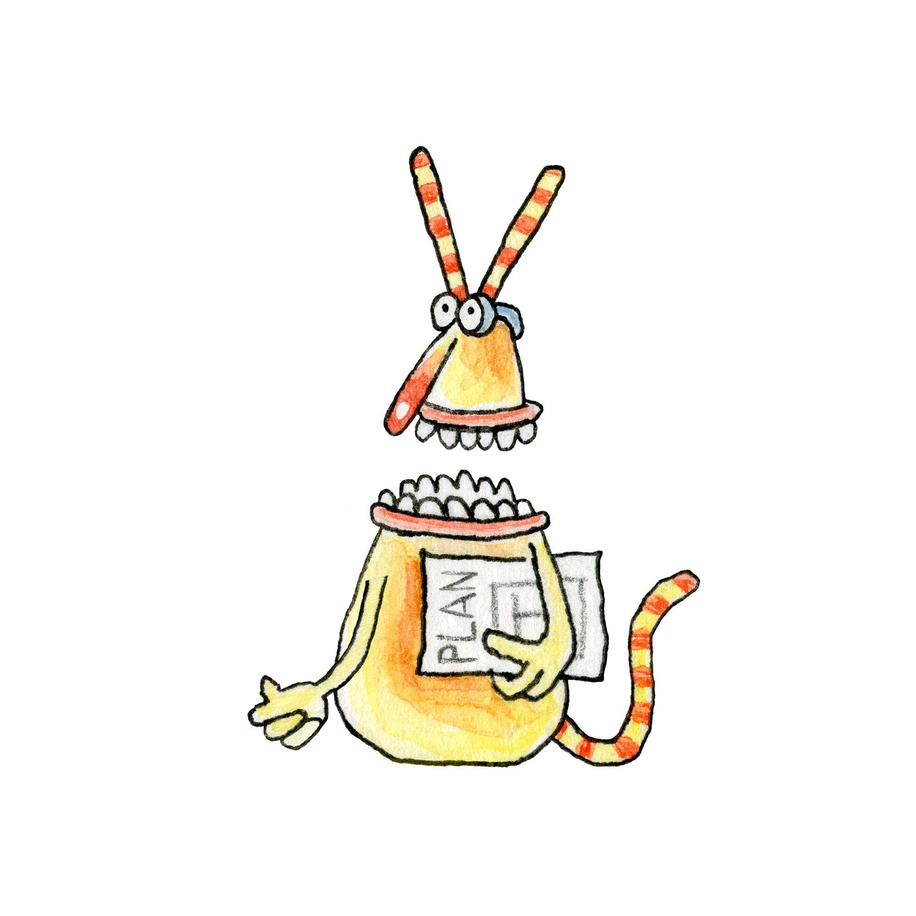
The Bongles tried to keep their treasure secure by using a padlock with a passcode.
What are passcodes for?
Can you think of examples of when we use passcodes?
Notes:
Start with a discussion about what passwords and passcodes are for.
Exemplars: to keep things safe, to stop people for taking things that are not theirs etc

Slide 4
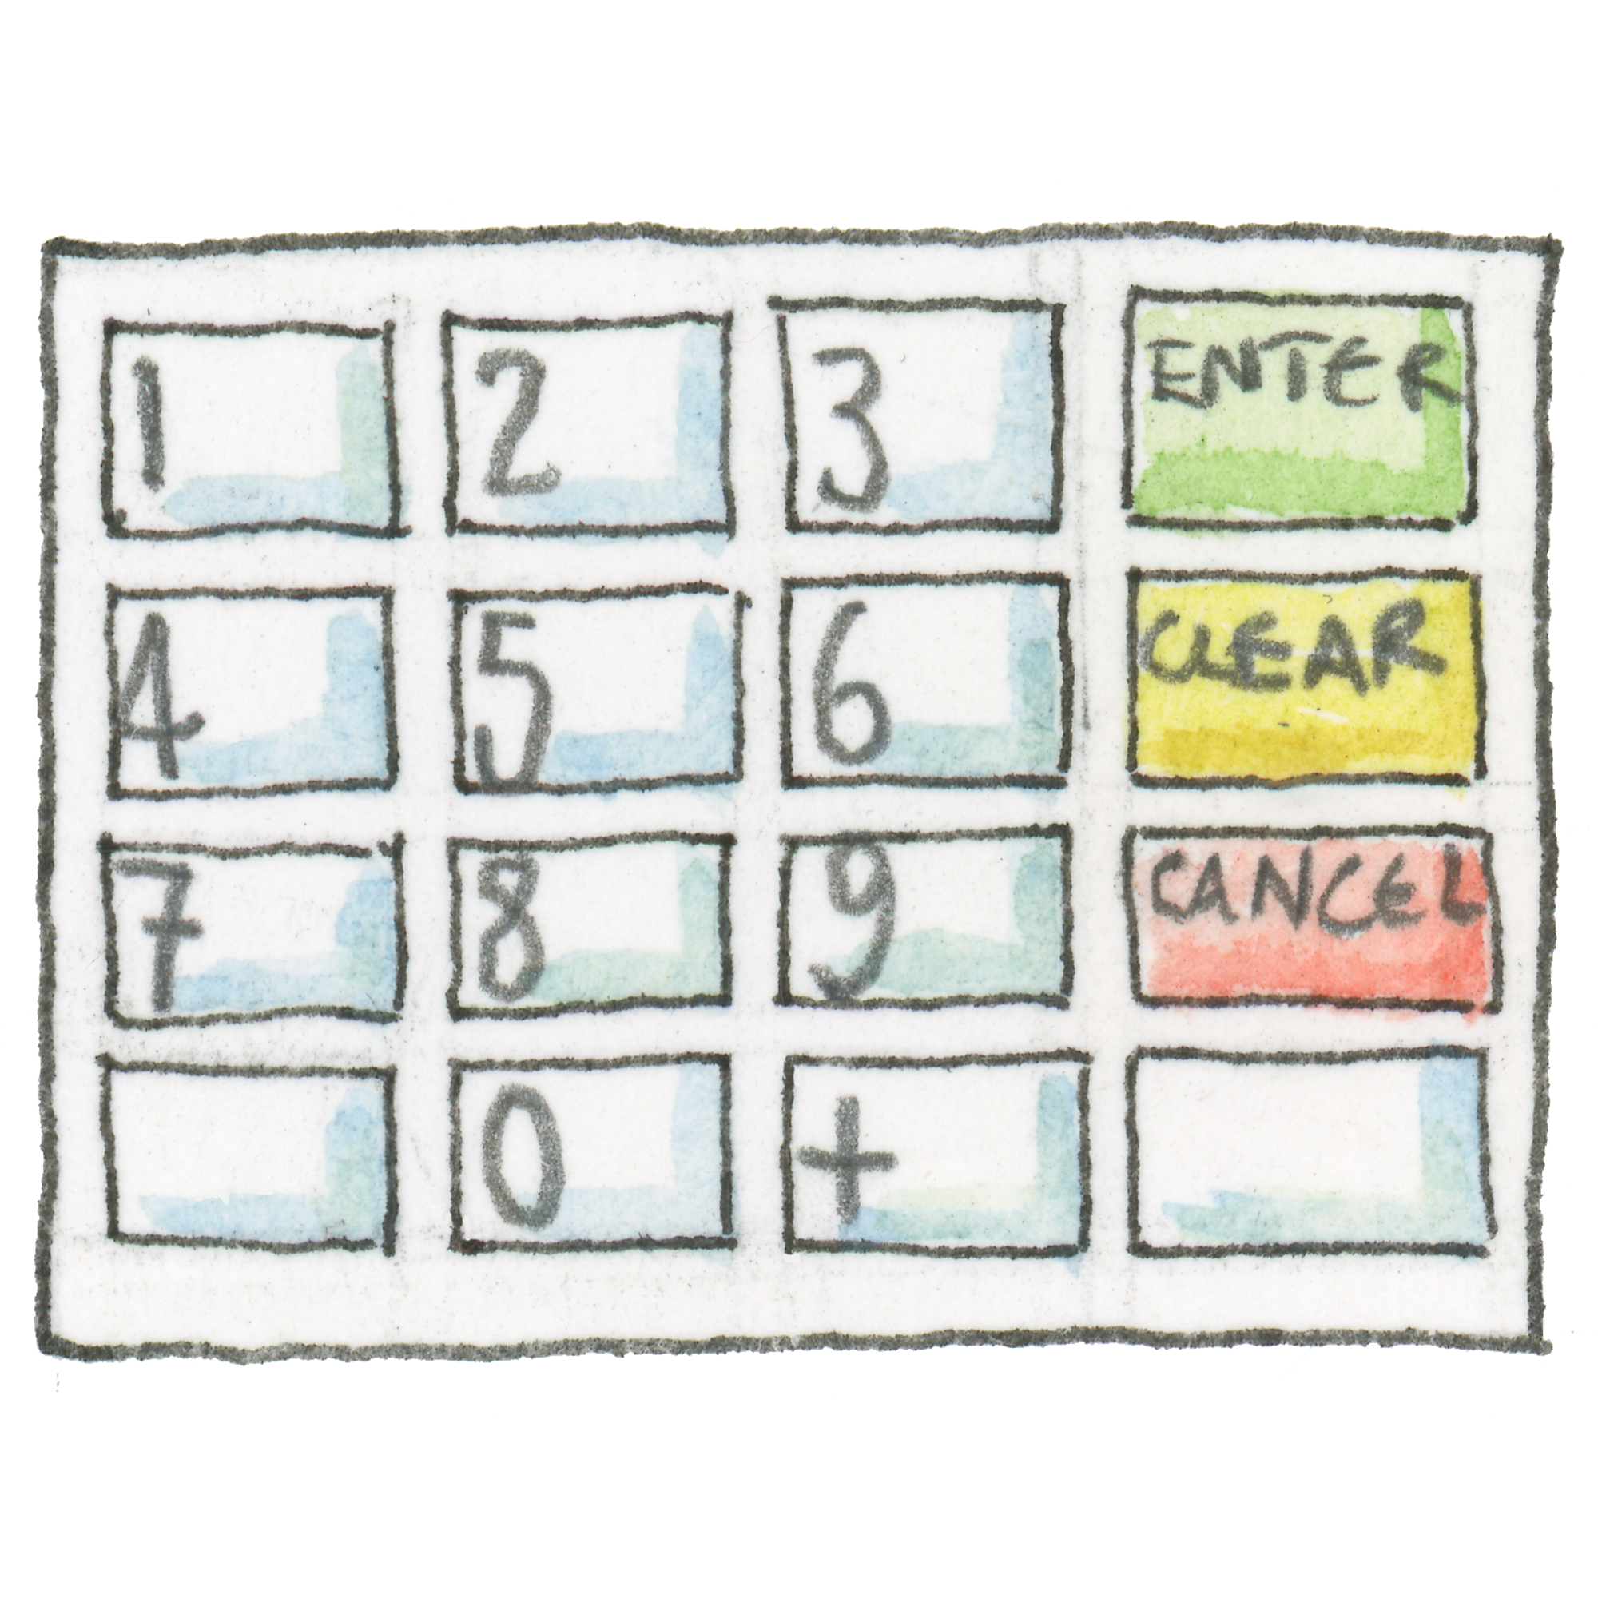
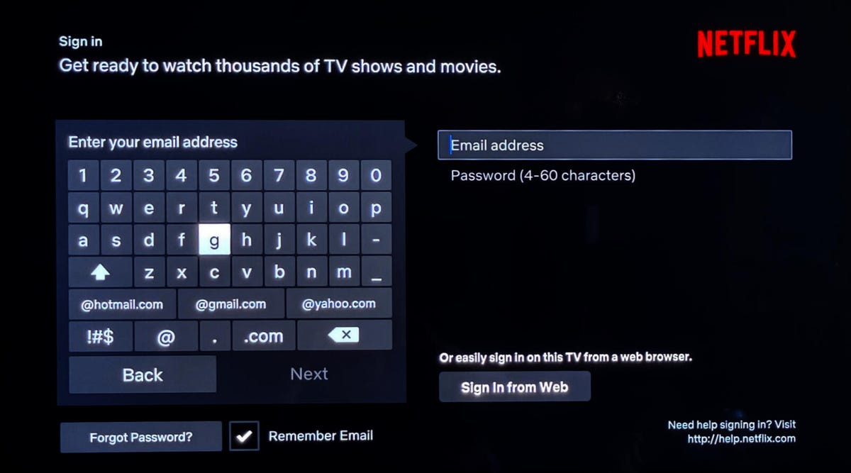
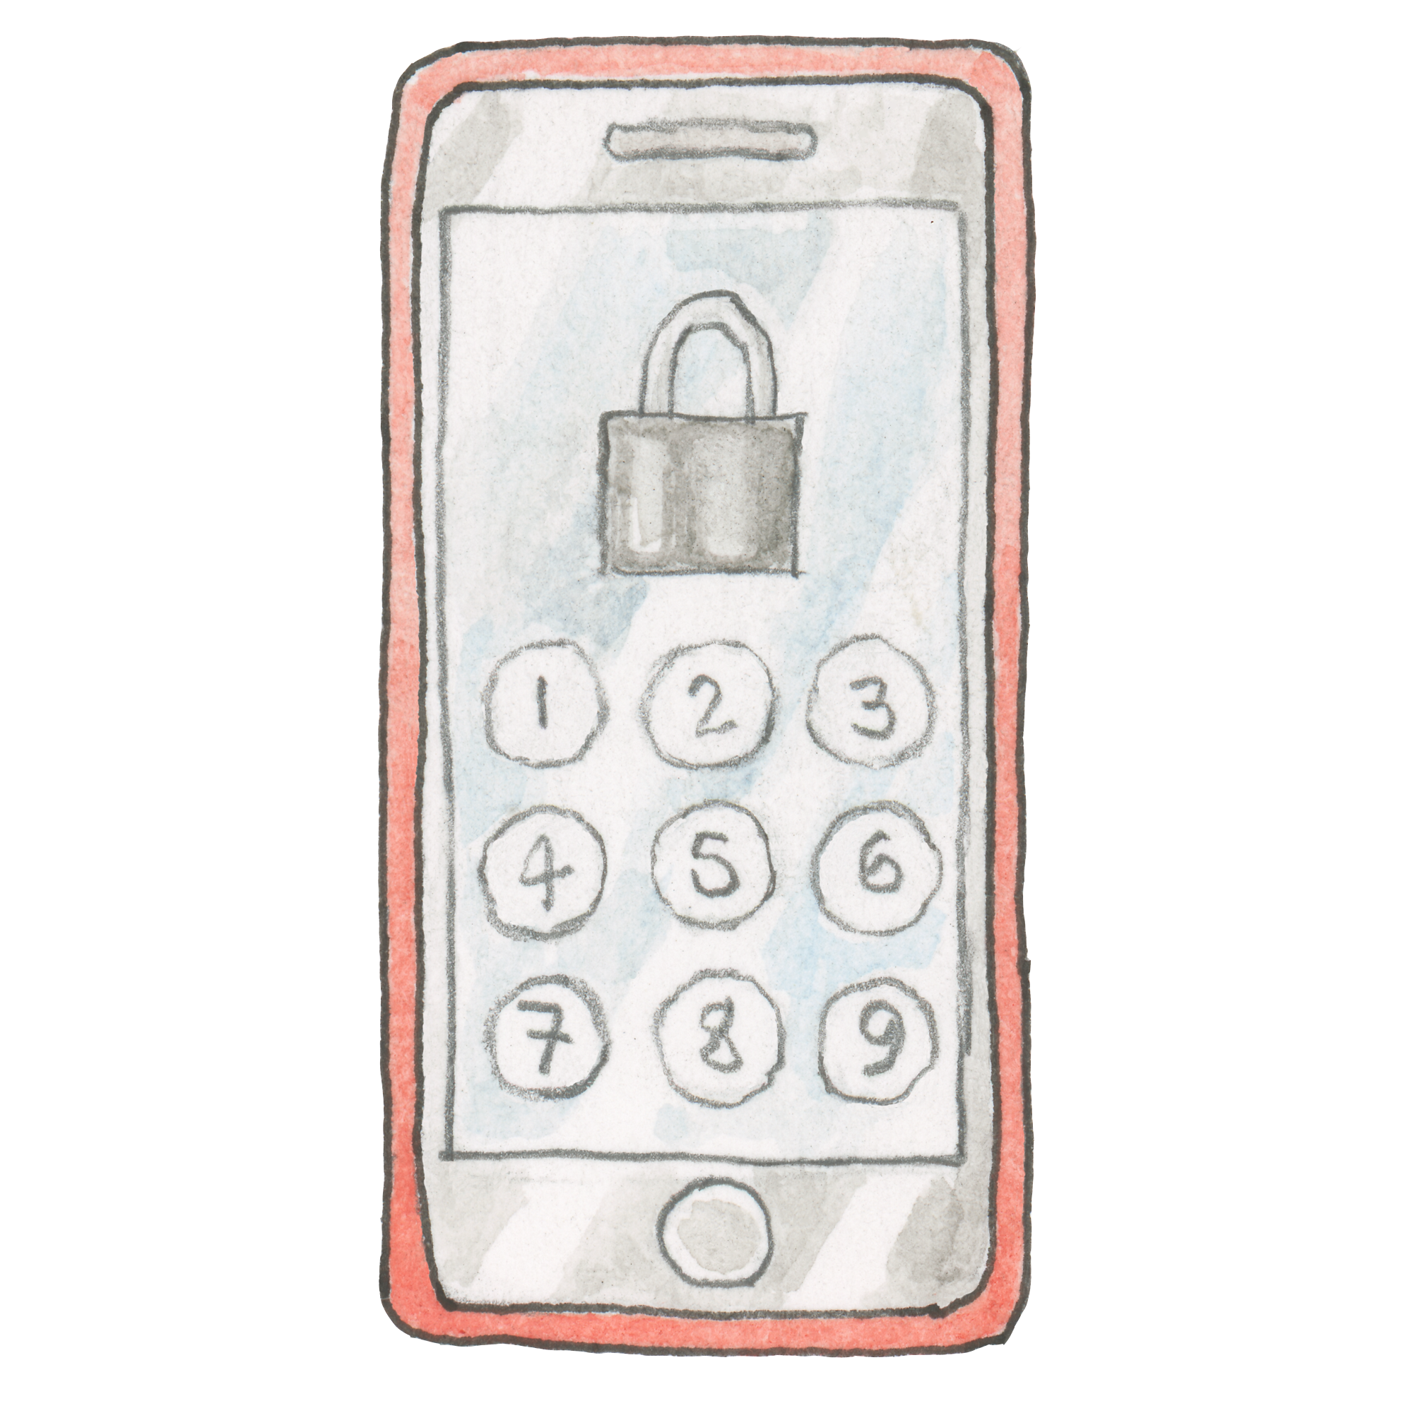
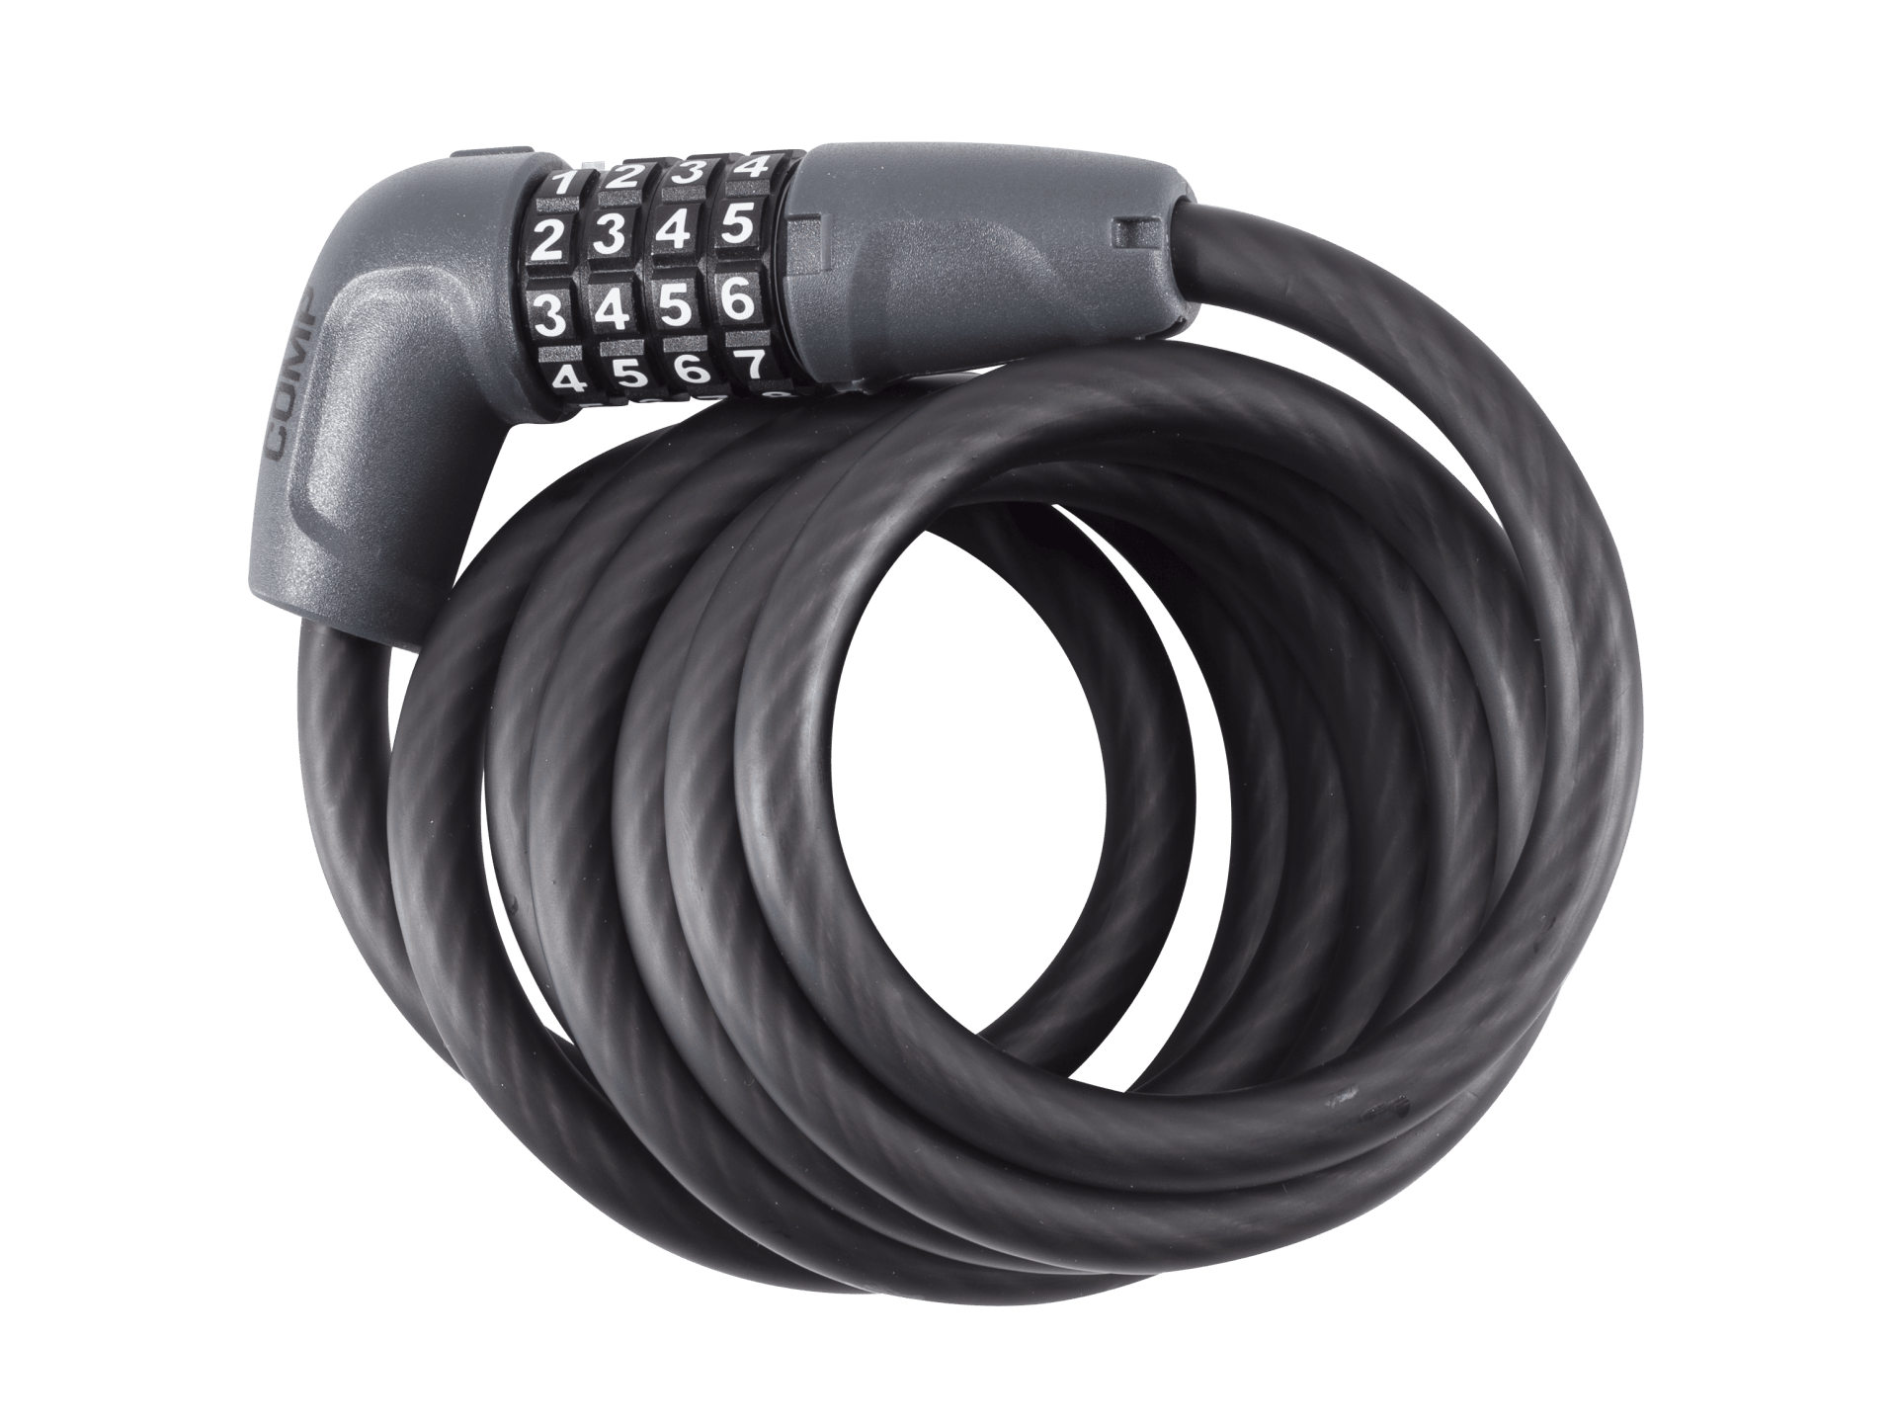
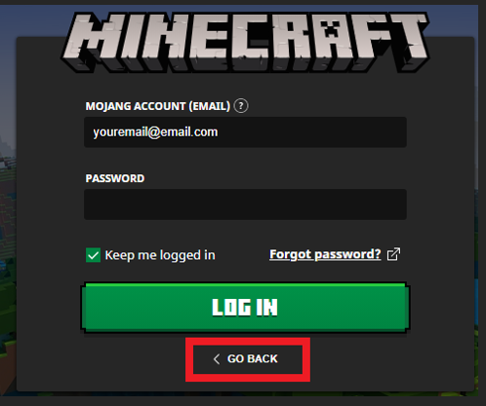
Notes:
- Discuss these different examples of passcodes and passwords.
- Explain how passcodes are just numbers, but passwords can (and should!) be a combination of words, numbers, and special characters/symbols.

Slide 5
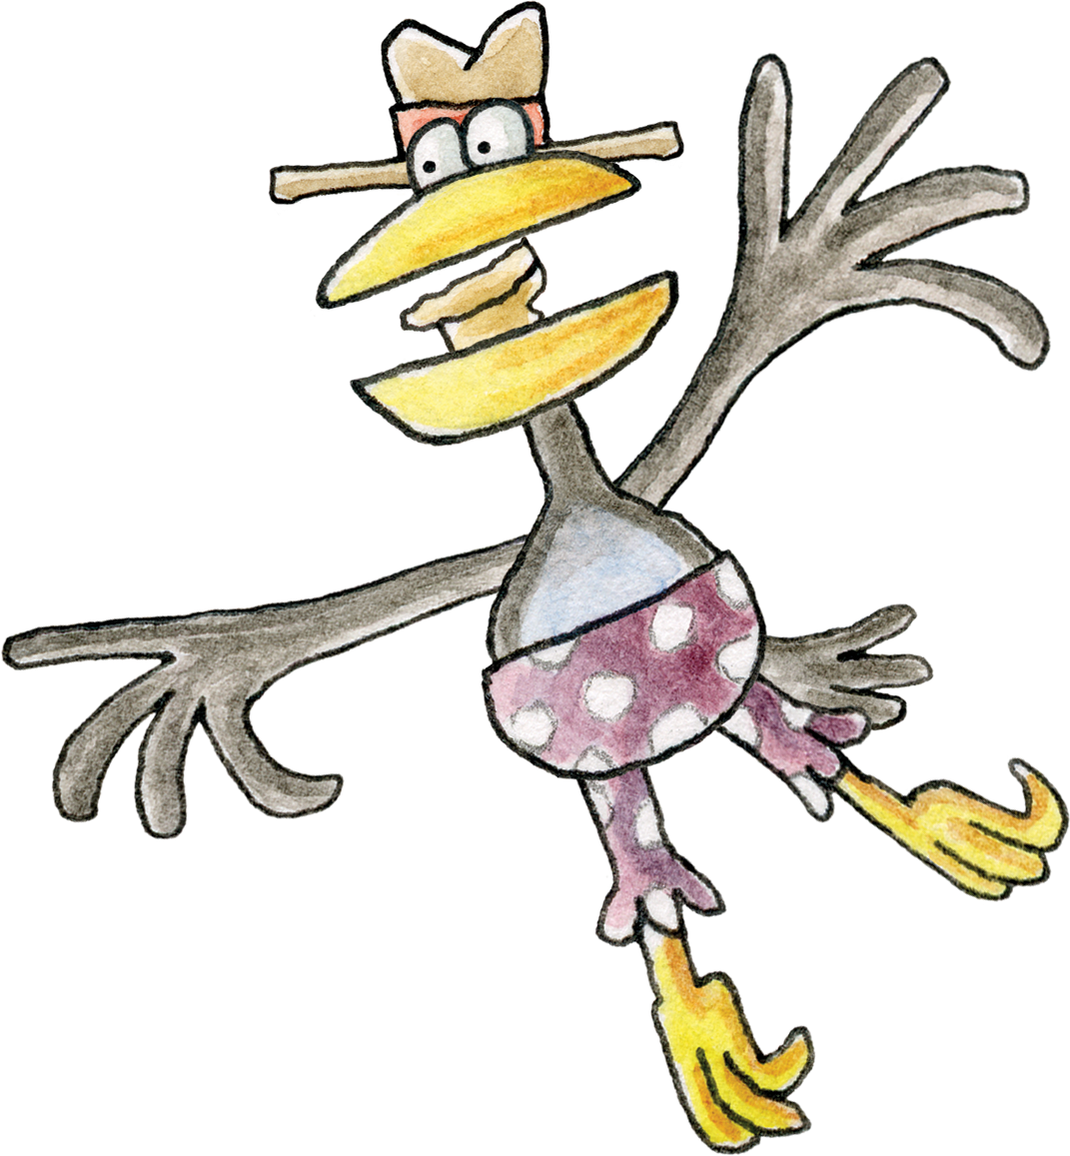
The crows found out the first passcode the Bongles had chosen.
How did they guess the passcode?
Notes:
Discuss how the crows managed to guess the first passcode
- e.g. they were watching when Bubba entered it, and it was easy to guess because the numbers were in order.

Slide 6
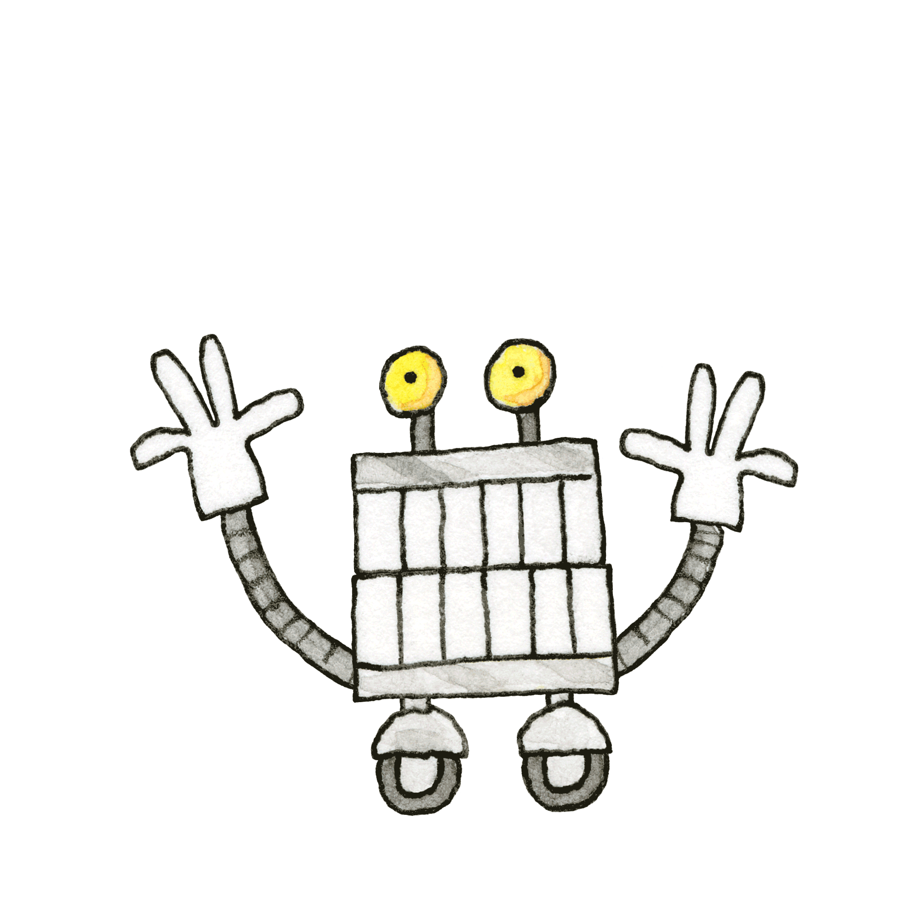
The Bongles figured out how they could make a more secure password: they chose three random words.
Notes:
- Talk about the meaning of these words:
- secure
- random

Slide 7
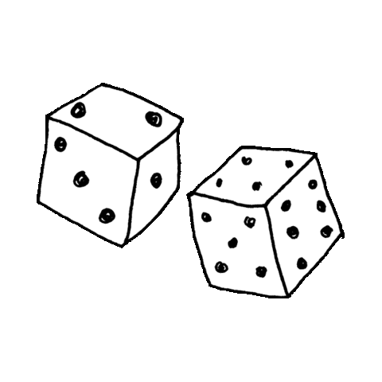
Let’s play a game to make our own three random word passwords!
Notes:
Instructions for the dice game:
- Make three lists of words on the board. Pick topics, for example: colours, animals, food, etc. Have six words in each list.
- Have pupils roll a dice and match the number to the word – depending on reading ability this may need to be played as a whole class. You could use normal dice, electronic dice in Activinspire, large blow-up dice
- Groups could then try and guess each other’s password – this should be almost impossible, showing that 3 random words is a secure way to choose a password.
- Discuss the word ‘random’

Slide 8
Colours
Weather
Animals
1. Red ❤️
1. Rain ☔
1. Mouse 🐁
2. Orange 🧡
2. Cloud ☁️
2. Crab 🦀
3. Yellow 💛
3. Snow ❄️
3. Snake 🐍
4. Green 💚
4. Lightning 🌩️
4. Badger 🦡
5. Blue 💙
5. Rainbow 🌈
5. Fish 🐠
6. Purple 💜
6. Wind 🍃
6. Shark 🦈
Notes:
You could use this example slide or make your own lists. Blank template is available in following slide.

Slide 9
1.
1.
1.
2.
2.
2.
3.
3.
3.
4.
4.
4.
5.
5.
5.
6.
6.
6.
Notes:
You could project this slide, and either fill in the text boxes, or use a whiteboard marker and take suggestions from the class.

